Slide 1
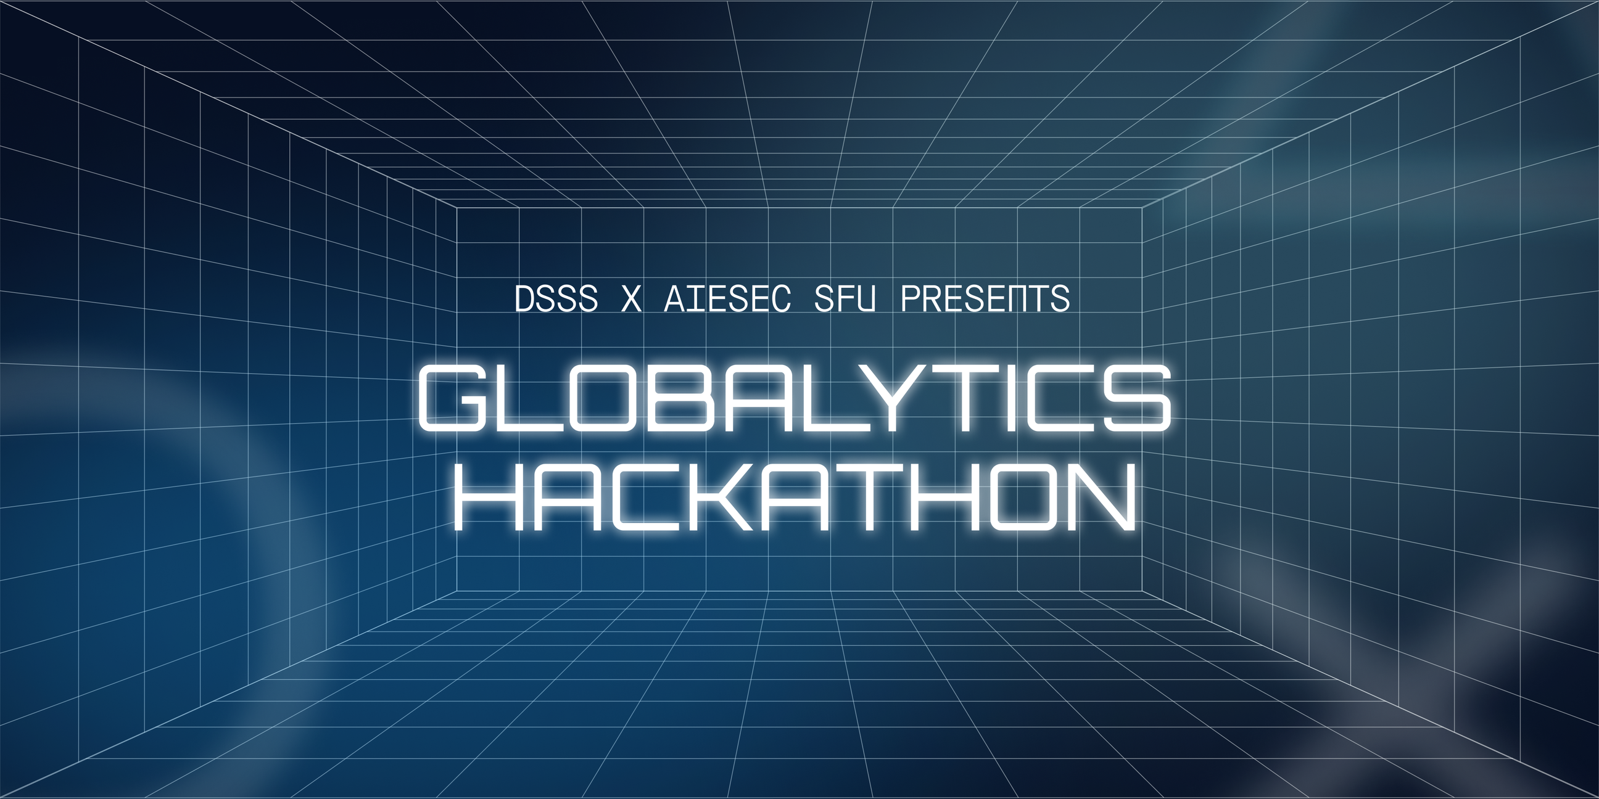
Grant Proposal for Globalytics Hackathon

Slide 2



What Is The Globalytics Hackathon?
Introduction
Objectives
Develop Data-Driven Problem Solving Skills
Learn how to identify insights and trends in datasets
Present insights clearly and effectively
Network with industry professionals
Boost confidences in technical and soft skills
The Globalytics Hackathon is a collaboration between AIESEC and the Data Science Student Society meant to provide students to use data visualization and strategic problem solving to solve real-world problems.

Slide 3
Hackathon Timeline
11:30 AM - 12:00 PM
12:00 PM - 1:00 PM
1:00 PM – 1:30 PM
1:30 PM – 3:30 PM
Check-in & Registration
Time for Final Refinements
Opening Ceremony
Introductory Presentation
3:30 PM – 4:20 PM
4:20 PM – 4:50 PM
5:00 PM – 6:00 PM
Lunch Break + Networking
Time for Finalists to Prepare
Final Team Presentation

Slide 4
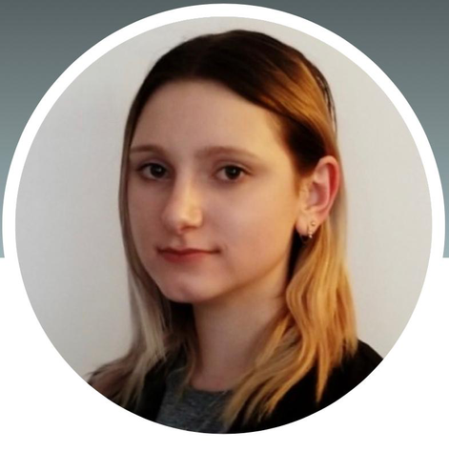
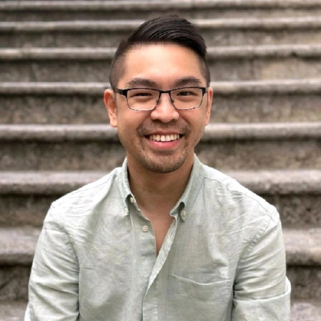
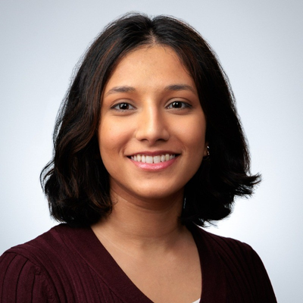
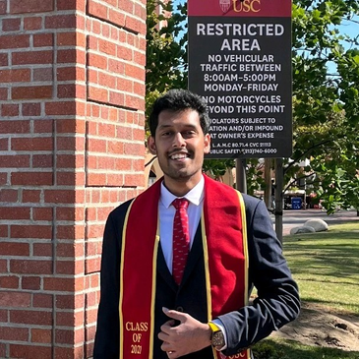
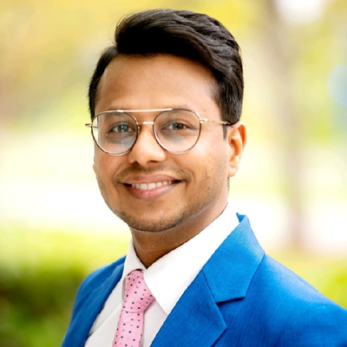
Number Of Attendees
There will be a total of 80 attendees at this event.
Judges
Sarah Macdonald
Decision Support Advisor
Vancouver Coastal Health
Alex Juy
Senior Principle Product Manager
MacroHealth
Nabia Doctor
Business Analyst
Providence Health Care
Utkarsh Bansal
Strategic Consultant
Leader in Healthcare, Data, AI & Innovation
Devansh Shah
Data Scientist
Microsoft

Slide 5



FINANCES
Revenue
Projected Expenses
In/Kind Sponsorships
$499
$284
$ 350 (catering)
$100 (setup)
Requested Amount
We are reaching out to request an additional $475 in funding for the Globalytics Hackathon. Initially, we requested $990, but only received $150, which does not fully cover our event needs. This additional funding will go towards speaker gifts and prizes to recognize and appreciate our guest speakers and participants. These elements are crucial in enhancing the experience and impact of the event.
$475

Slide 6


Thank You!
Any Questions?

